Slide 1
Career Structure Hospital Medical and Dental Staff
TRUST POSTS
Clinical Fellow
Research Fellow
FTSTA’S
Fixed Term Specialty Training Appointment – a training opportunity outside of the ‘standard’ rotation.
Consultant
Medical School
Foundation Year One (F1’s)
Foundation Year Two (F2’s)
Complete CCT
The Certificate of Completion of Training is the certificate to indicate that they have completed training in their chosen specialty
Core Training Year 1 (CT1)
Core Training Year 2 (CT2)
Core Training Year 3 (EM & Psychiatry ACCS)
Run through training in Specialities (ST1 – ST2)
Specialty Training Registrar (StR) Year 3 onwards
GP Training Scheme GPVTS
GP
Specialty Trainee Dental DCT
Specialty Doctor
Closed Grades
House Officer (HO) – F1
Senior House Officer (SHO) – F2
Staff Grade – STR equivalent
Associate Specialist – closest equivalent Specialty Doctor
All doctors will complete two years of a Foundation Training programme once graduating from Medical School. This is a requirement to obtain a GMC. After FY2, depending on their chosen career path, they can take a number of training routes – Specialty Training, Core Training or Dental Core & GP Training. On completion of the training in their specialty which can take up to 8 years; they are eligible to apply for a Certificate of completion of Training (CCT) which is required to become a Consultant. ‘Non-training doctors’ or Trust posts can come in at any level after Foundation – the work done over the course of a Trust post does not count towards their CCT and training but is a good opportunity for additional experience.
Sally McCreith

Slide 2
Lead Employer Doctors vs Locally Employed Doctors (Trust Grades)
Lead Employer
(St Helens & Knowsley Employed, Aintree Host)
Apply via Health Education England (HEE) Deanery to a recognised training programme.
Employed by Lead Employer and allocated to Host Trust
Locally Employed
(Aintree Employed)
Apply to post usually via NHS jobs.
Recruitment checks undertaken by LUHFT recruitment team.
Contract of Employment is LUHFT Terms and Conditions.
Recruitment checks undertaken by Lead Employer recruitment team
Post is a training post - and work completed counts towards overall training and CCT certificate
Tariff funded posts. (Tariff posts are set cost posts at a nationally agreed figure, the sum of which covers all direct costs of education and training).
Stay in one specialty for duration of fixed term contract
Funded by Trust unless there is a genuine vacancy in Deanery funded posts.
Post is ‘out of programme’ and does not count towards overall training, used as an opportunity to gain increased experience.
Rotate across Specialties every 4 – 6 months.
Sally McCreith

Slide 3
The New Junior Doctors Contract A summary of some of the changes new 2016 doctors contract.
Pay
Changes to the new basic rate of pay.
Changes to additional allowances and how they are calculated.
Working Hours
Increased restrictions on working hours to ensure safer working ;
Maximum 8 consecutive shifts (previously 12)
Work Scheduling/ Exception Reporting
In addition to T&C’s, doctors will receive a work schedule which identifies pay, working pattern and training opportunities.
Exception reports to replace hours monitoring. Means any changes to schedule can be flagged in real time rather than bi-annually.
Where a doctor intends to undertake hours of paid work as a locum, additional to the hours set out in the work schedule, the doctor must initially offer such additional hours of work exclusively to the service of the NHS via an NHS staff bank.
Maximum 72 hours work in any 7 day period (previously 91)
Maximum 5 consecutive long shifts (previously 7)
Maximum 4 consecutive night shifts (previously 7)
Maximum 48 hour working week (previously 56)
Doctor’s pay will now link directly to the work they do and the level of responsibility they discharge, with doctors working the most onerous patterns will be more fairly rewarded.
Additional Work
Sally McCreith

Slide 4
Old to New Grades

Slide 5
Doctor’s Contract - General
Annual Leave
Study Leave
Foundation Year 1 doctors – 15 days per annum
All other doctors in training – 30 days per annum
Contractual Notice Periods
Study leave for FY1 will take the form of regular scheduled teaching agreed locally.)
Study leave for FY2 will include scheduled teaching but can also include external courses and preparing for / sitting examinations.
Junior Doctors – (Trainees, Fellows, Registrars)
On first appointment to NHS leave entitlement is 27 days.
After five years’ completed NHS service is 32 days.
Consultants & SAS Doctors
On first appointment, 32 days.
After 7 years completed as a Consultant, 34 days.
Grade | Period
F1, F2, StR Core Training (CT), Dental Foundation/Core Trainee | One Month
StR (Run-through), StR (Higher Specialty), GP Specialty Trainee, SpR | Three Months
Sally McCreith

Slide 6
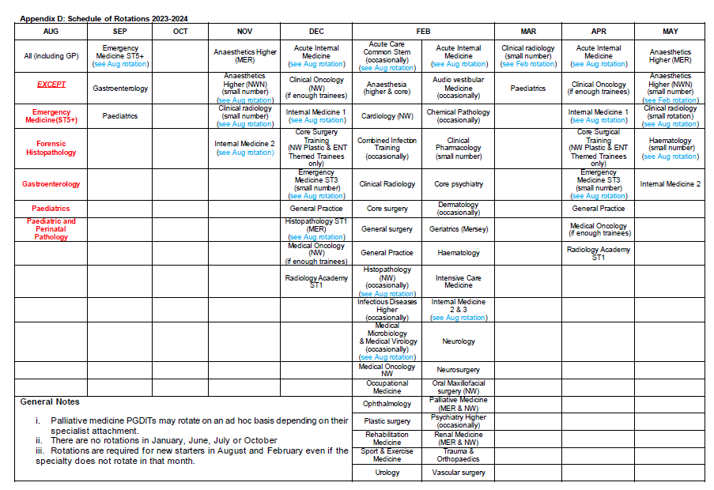
Hosted Trainee Rotations 23/24

Slide 7
Useful Links
Doctors and dentists in training terms and conditions (England) 2016 | NHS Employers
bma-junior-doctors-contracts-pay-tables-apr-2022-2023.pdf
Health Education England - North West: Postgraduate Medicine and Dentistry | Health Education North West (nwpgmd.nhs.uk)
https://staffhub.liverpoolft.nhs.uk/working-with-us/Manager%20Support.htm
Sally McCreith

